Slide 1
DML STATEMENTs
Instructor:

Slide 2

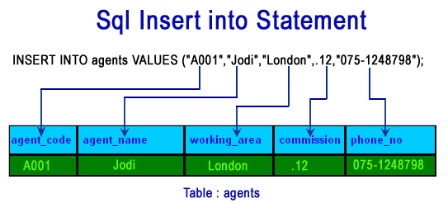


Learning Goals
By the end of this lecture students should be able to:
Describe each data manipulation language (DML) statement
Insert rows into a table
Update rows in a table
Delete rows from a table

Slide 3
Table of contents
Insert Statement
Update Statement
Delete Statement
Select Statement

Slide 4
Insert statement
Section1

Slide 5
Insert Statements (1/3)
The INSERT INTO statement is used to adds one or more rows to a table or a view

Slide 6
Insert Statements (2/3)
Syntax:
Ex1: USE Fsoft_Training
INSERT INTO dbo.Persons
VALUES ( 1,'Tom', 'B. Erichsen','Skagen 21','Stavanger')
Ex2: USE Fsoft_Training
INSERT INTO dbo.Customer (CustomerName, City, Country)
VALUES ('Cardinal', 'Stavanger', 'Norway');
(1) Inserting data to all columns
INSERT INTO table_name
VALUES (value1,value2,value3,...);
(2) Inserting data to selected columns
INSERT INTO table_name(column1,column2,column3,...)
VALUES (value1,value2,value3,...);

Slide 7
Insert Statement (3/3)
Demo
Inserting data to selected columns
Inserting data to all columns with identity column
Insert many rows at one time
Notes:
SET IDENTITY_INSERT [dbo].[Patient] ON/OFF

Slide 8
Insert in practice
Always check data in various cases:
Normal/Abnormal
Invalid data type
Special characters: ~!@#$%^&*()_
Special string characters: ‘ char(10) char(13) tab space
Max length, Max/Min value
Duplicated value in UNIQUE constraints

Slide 9
UPDATE statement
Section2

Slide 10
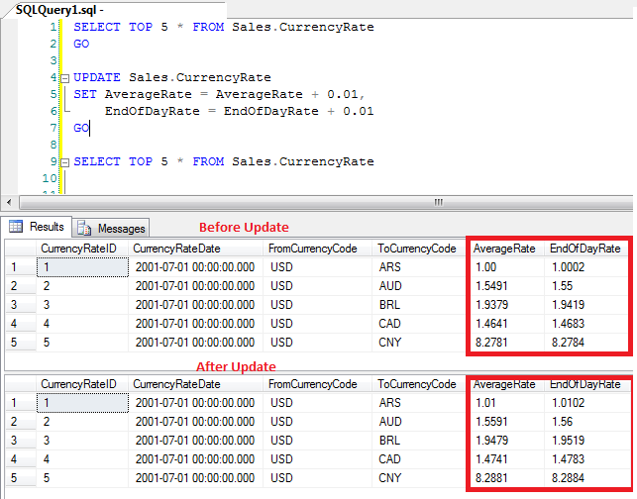
Update Statement (1/2)
The UPDATE statement is used to changes existing data in a table or view
Best Practice
Use the @@ROWCOUNT function to return the number of inserted rows to the client application.

Slide 11

Update Statement (2/2)
Syntax:
Notice the WHERE clause in the SQL UPDATE statement!
The WHERE clause specifies which record or records that should be updated. If you omit the WHERE clause, all records will be updated!
Ex: USE Fsoft_Training
UPDATE dbo.Customer
SET PostalCode = '4006'
WHERE Country = 'Norway'
SELECT @@ROWCOUNT AS ROW_COUNT
UPDATE table_name SET column1=value1,column2=value2,... WHERE some_column=some_value;

Slide 12
DELETE statement
Section3

Slide 13
Delete Statement (1/2)
Removes one or more rows from a table or view
Best Practice:
To delete all the rows in a table, use TRUNCATE TABLE. TRUNCATE TABLE is faster than DELETE and uses fewer system and transaction log resources.
TRUNCATE TABLE has restrictions, for example, the table cannot participate in replication
CustomerId | CustomerName | ContactName
1 | Alfreds Futterkiste | Maria Anders
2 | Around the Horn | Thomas Hardy
3 | Berglunds snabbköp | Christina Berglund
4 | Antonio Moreno | Antonio Moreno
5 | Ana Trujillo | Ana Trujillo

Slide 14

Delete Statement (2/2)
Syntax:
Notice the WHERE clause in the SQL DELETE statement!
The WHERE clause specifies which record or records that should be deleted. If you omit the WHERE clause, all records will be deleted!
Please note that the DELETE FROM command cannot delete any rows of data that would violate FOREIGN KEY or other constraints.
Ex:
USE Fsoft_Training
DELETE dbo.Customer
WHERE Country = 'Germany'
SELECT @@ROWCOUNT AS ROW_COUNT
DELETE FROM table_name WHERE some_column=some_value;

Slide 15
SELECT statement
Section4

Slide 16

SELECT Statement (1/4)
Retrieves rows from the database and enables the selection of one or many rows or columns from one or many tables
Notes:
To execute a statement in MS SQL, Select the statement and Click on the Execute button in the query analyser or press F5

Slide 17
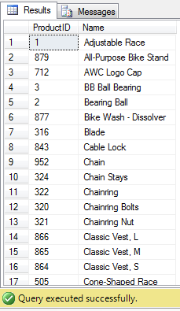
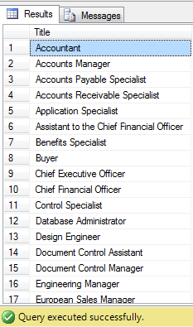
SELECT Statement (2/4)
Syntax:
SELECT [ALL/DISTINCT/TOP [ WITH TIES ] ] <Column name1>, <Column name2>,..
FROM <Table name>
[WHERE <Search condition>]
[GROUP BY grouping columns]
[HAVING search condition]
[ORDER BY sort specification]
Ex1: USE AdventureWorks
GO
SELECT ProductID, Name
FROM Production.Product
ORDER BY Name ASC;
(504 rows)
Ex2: SELECT DISTINCT E.Title
FROM HumanResources.Employee E
ORDER BY E.Title;
(67 rows)
Notes:
To execute a statement in MS SQL, Select the statement and Click on the Execute button in the query analyser or press F5

Slide 18
SELECT Statement (3/4)
The SELECT INTO statement selects data from one table and inserts it into a different table.
Syntax:
SELECT *
INTO new_table_name
FROM old_tablename
Tip:
The SELECT INTO statement can also be used to create a new, empty table using the schema of another. Just add a WHERE clause that causes the query to return no data:
SELECT *
INTO newtable
FROM table1
WHERE 1=0;
Notes:
The TOP clause can be very useful on large tables with thousands of records. Returning a large number of records can impact on performance.

Slide 19
SELECT Statement (4/4)
SQL Alias syntax:
For table
SELECT column_name(s)
FROM table_name AS alias_name
For Column(s)
SELECT column_name AS alias_name
FROM table_name
Ex:
USE AdventureWorks
GO
SELECT c.CustomerID, s.Name
FROM Sales.Customer AS c
JOIN Sales.Store AS s
ON c.CustomerID = s.SalesPersonID

Slide 20

Summary
Insert StatementStatement
Delete Statement
Select Statement

Slide 21
Thank you
21

